Slide 1
364149
Game Mechanics Programming
Week 8 | Sem 1
Multiplayer 1

Slide 2
Animation
Animation Concepts
Active Ragdoll
Inverse Kinematics
UE4 Animation Components

Slide 3
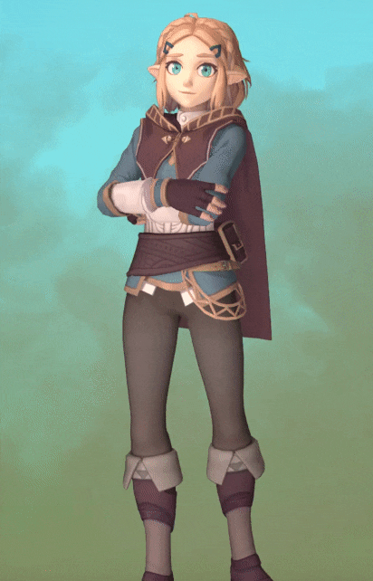
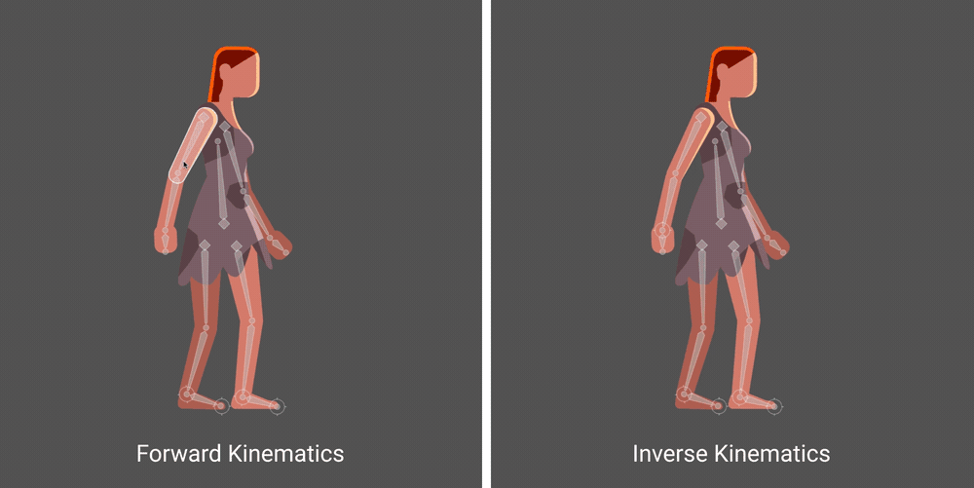
Animation Recap
Vertices get their position from a blend of bone positions
Bones get their position from a blend of y weights
Vertices get their position from a blend of x positions
Vertices get their position from a blend of bone positions
Bones get their position from a blend of Animation Control weights
Animation Controls get their weight from a blend of Anim Layer weights
Vertices get their position from a blend of bone positions
Bones get their position from a blend of Animation Control weights
Animation Controls get their weight from a blend of z weights
3 Elements make up an active Ragdoll
Perfect IK solve
Character skeleton rigged with physics joints
AI to moderate the forces and keep the character on the IK solve

Slide 4
Multiplayer 1 – This one’s tricky
GameModes and Maps
The Game Instance
Replication and Multicasting

Slide 5
Game Modes
And
Maps

Slide 6
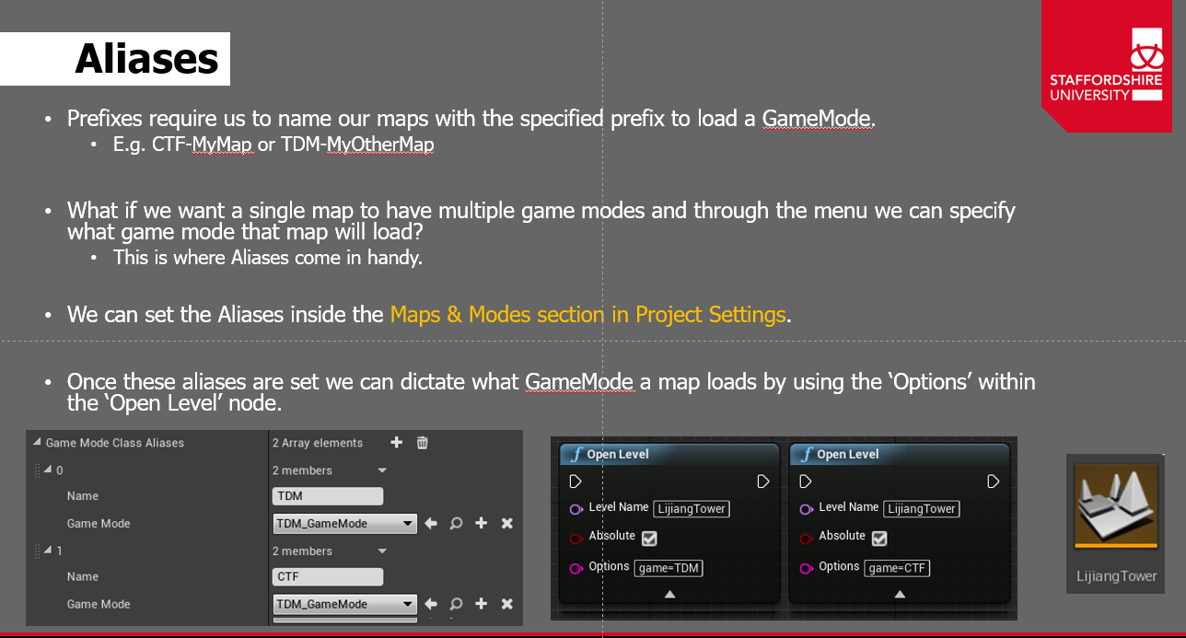
Game Modes
We know from GEP that the GameMode should handle all logic that decides the end of the game
We also know that Maps can have GameModes set within the world settings
How do we use a single map with lots of different modes?
Aliases
In Project Settings > Maps & Modes you can register aliases for GameModes

Slide 7
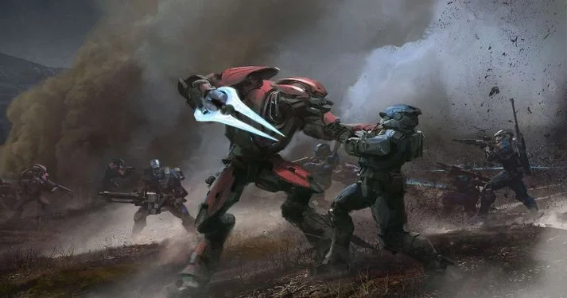
Designing Maps for All
Now we need to make our Maps work with different Modes:
Interface for GameModeItem with Boolean function for querying game mode type
Sift through all actors in the scene on load
Delete or deactivate objects that don’t match
Register objects for this mode in a Tarray
Use the interface to pass through MatchStates and run mode
With this setup we can have CTF, Rush and TDM all on the same map
Lets consider Invasion in Halo: Reach
Made up of 3 Phases each giving access to more equipment
Attackers have 4 minutes to occupy both zones close to the defenders spawn for 20 seconds each
Spawns move back and attackers then have a further 4 minutes to occupy 1 of 2 new zones for 30 seconds
Spawns then swap and the attackers have 4 minutes to take a data core from the newly gained area back to their start point
Notes:
Timers for each phase or a single timer that going up a phase adds time onto
Moveable spawn points or a tagging system so certain spawns are available in different phases
Hard-point zones for phase 1 and 2 with differing capture time (AND gate then OR gate)
Data Core for phase 3 to spawn when phase starts
Objects to lock the later sections of the map off (closed doors, forcefields, rocks in the way) + effects to move them
Kill zones need to move as the map progresses

Slide 8
The Game Instance

Slide 9
The Game Instance
The Game Instance is the single constant in your game
It travels between levels and is always referenceable – a bit like a singleton – boo hiss
We can use it as a data store for things like:
Amount of players to load in
Chosen classes and player settings between level load (if you chose your character in the main menu)
It should be the first thing your GameMode calls when it starts to pull data from other maps
You can then spawn the correct amount of PlayerControllers for split screen etc
It also works as the session reference for matchmaking in multiplayer

Slide 10
Replication
&
Multicasting

Slide 11


Replication
Replication is the process of “replicating” the value of variables and function calls across a network
Mark any variable as replicated and the value will be the same on all clients and servers
Variables can also be set as RepNotify this form of replication sends the updated value across the network and calls the associated onRep_<variableName> function everywhere
Server
Client
Variable A = 7
Replicated Variable B = 5
RepNotify Variable C = 3
OnRep_C()
Variable A = 7
Replicated Variable B = 5
RepNotify Variable C = 4
OnRep_C()
Variable A = 9
Replicated Variable B = 5
RepNotify Variable C = 3
OnRep_C()
Variable A = 9
Replicated Variable B = 5
RepNotify Variable C = 4
OnRep_C()

Slide 12
MultiCasting
Multi Casting is the process of firing functions on the server/owned client/all members
Player 1 (Server)
Player 2 (Client)
Game Instance
Persistent
Game Mode
Player Controller 1
Player Controller 2
(copy)
Player Controller 1
(copy)
Player Controller 2
Pawn 1
Pawn 2
(copy)
Pawn 1
(copy)
Pawn 2
Notes:
Server – function called from anywhere will execute on the servers version of that object
Owned Client – Called on any object will call on the client that “owns that object” – best used on the server’s copies of objects
Multicast - will call on all versions of an object

Slide 13
MultiCasting
Multi Casting is the process of firing functions on the server/owned client/all members
Player 1 (Server)
Player 2 (Client)
Game Instance
Persistent
Game Mode
Player Controller 1
Player Controller 2
(copy)
Player Controller 1
(copy)
Player Controller 2
Pawn 1
Pawn 2
(copy)
Pawn 1
(copy)
Pawn 2
Notes:
Server – function called from anywhere will execute on the servers version of that object
Owned Client – Called on any object will call on the client that “owns that object” – best used on the server’s copies of objects
Multicast - will call on all versions of an object

Slide 14
MultiCasting
Multi Casting is the process of firing functions on the server/owned client/all members
Player 1 (Server)
Player 2 (Client)
Game Instance
Persistent
Game Mode
Player Controller 1
Player Controller 2
(copy)
Player Controller 1
(copy)
Player Controller 2
Pawn 1
Pawn 2
(copy)
Pawn 1
(copy)
Pawn 2
Notes:
Server – function called from anywhere will execute on the servers version of that object
Owned Client – Called on any object will call on the client that “owns that object” – best used on the server’s copies of objects
Multicast - will call on all versions of an object

Slide 15
MultiCasting
Multi Casting is the process of firing functions on the server/owned client/all members
Player 1 (Server)
Player 2 (Client)
Game Instance
Persistent
Game Mode
Player Controller 1
Player Controller 2
(copy)
Player Controller 1
(copy)
Player Controller 2
Pawn 1
Pawn 2
(copy)
Pawn 1
(copy)
Pawn 2
Notes:
Server – function called from anywhere will execute on the servers version of that object
Owned Client – Called on any object will call on the client that “owns that object” – best used on the server’s copies of objects
Multicast - will call on all versions of an object

Slide 16
MultiCasting
Multi Casting is the process of firing functions on the server/owned client/all members
Player 1 (Server)
Player 2 (Client)
Game Instance
Persistent
Game Mode
Player Controller 1
Player Controller 2
(copy)
Player Controller 1
(copy)
Player Controller 2
Pawn 1
Pawn 2
(copy)
Pawn 1
(copy)
Pawn 2
Notes:
Server – function called from anywhere will execute on the servers version of that object
Owned Client – Called on any object will call on the client that “owns that object” – best used on the server’s copies of objects
Multicast - will call on all versions of an object

Slide 17
MultiCasting
Multi Casting is the process of firing functions on the server/owned client/Multicast
Player 1 (Server)
Player 2 (Client)
Game Instance
Persistent
Game Mode
Player Controller 1
Player Controller 2
(copy)
Player Controller 1
(copy)
Player Controller 2
Pawn 1
Pawn 2
(copy)
Pawn 1
(copy)
Pawn 2
Notes:
Server – function called from anywhere will execute on the servers version of that object
Owned Client – Called on any object will call on the client that “owns that object” – best used on the server’s copies of objects
Multicast - will call on all versions of an object

Slide 18
Multiplayer
GameModes and Maps
The Game Instance
Replication and Multicasting

Slide 19

Q&A

